Slide 1
TASK 2 Modeling & Simulation Fall 2013 Workflow
web software to support decision making
in building retrofit projects
Workflow + Case Study: Building101 tools.eebhub.org | developer.eebhub.org

Slide 2
4 Platform Tools with different analytical capabilities
designed to engage the owner throughout a building retrofit lifecycle
tools.eebhub.org/visitors
over 600 visits & 2,000 page views last month!
tools.eebhub.org

Slide 3
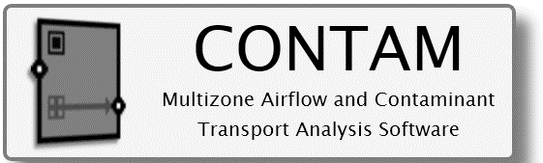
Simulation Platform PEOPLE
USERS
building
owners
building
designers
building
auditors
building
analysts
DEVELOPERS
Energy Audit Tool
Retrofit Manager
Inverse Modeling
Toolkit
Design Advisor
CoolVent
Urban Weather Generator
integrates
Portfolio Inverse Modeling
iPad Audit Interface
Manufacturer Materials
Benchmarking
Parametric Analysis
Toolkit

Slide 4
INPUTS to platform interface
DATA FLOW
among
platform
tools
RESULTS from simulation engine
KEY for DATA FLOW

Slide 5
Simulation Platform DATA
utility data
weather
typical room
shape of building
3D geometry,
efficiency measures
INPUTS
Benchmarking
Issues
+ EUI actual
Systems
Issues
SubSystem
to refine
OUTPUTS
Energy Use
Intensity
Systems
Benchmark
SubSystems
Audit
Installation
Staging
Benchmark
with EnergyStar,
CBECS, EIA, LEED
General System
Components
Breakdown
Targeted SubSystem
Replacement
Investigation
EUI actual vs. simulated
Daylighting, Airflow,
& all EnergyPlus Files
based on climate/budget
1-5
5-15
30-50
40-50
MEASURES >

Slide 6
Retrofit Analysis

Slide 7
COMPREHENSIVE Inputs & Outputs
building shape
air tightness level
typical room on each facade
+3D geometry
import
+owner desired
energy conservation measures
Building Component Library
SUBSTANTIAL
40-80 Low > High Cost Measures with Retrofit Staging Timeline
DAYSIM: Shade Schedule
Lighting Shade Schedule, Spatial Daylight Autonomy, Critical Point Illuminance, Occupancy Sensors
CONTAM airflow, EnergyPlus energy use (heating/cooling)
+ all files (.idf, .rad, .sql) for experts
ECM Categories: Lighting/Daylighting, Plug/Process, Occupant, Envelope, HVAC

Slide 8
COMPREHENSIVE Daylighting, Airflow, Energy
OpenStudio input file created
Daylight Data File by Orientation
Hourly Shade Operation Schedule
Hourly Lighting Power Fraction
Building Energy Performance with Integrated Daylighting Controls,
Airflow, and Contaminant Transport Impacts
Annual Zone Lighting Energy & Savings
Airflow Calculation
(representative spaces
on each orientation)

Slide 9
Daysim Development
Penn State added photosensor control system modeling and other modeling features (electric lighting, advanced shading device operation, system calibration, etc.), to the original version of Daysim that was developed by NRC-Canada & Fraunhofer Institute.
DAYSIMps is downloadable from www.daysim.ning.com.
The EEB Hub funded Daysim enhancements and the development of standalone Daysim modules for implementation in other programs.
A new user interface is currently being developed using OpenStudio’s menu system to apply these enhancements in an updated (new) version of DAYSIMps.

Slide 10
Daylight Energy Savings Calculations
Typical spaces are applied at the center of each façade.
Window specifications determine whether ribbon or punched windows are considered (by façade).
EPW weather data are applied to determine hourly sky conditions using Perez skies.
Shading devices are applied on an hourly basis to block direct sunlight.
Blinds = 20% transmittance
Fabric Shades = 5% transmittance

Slide 11
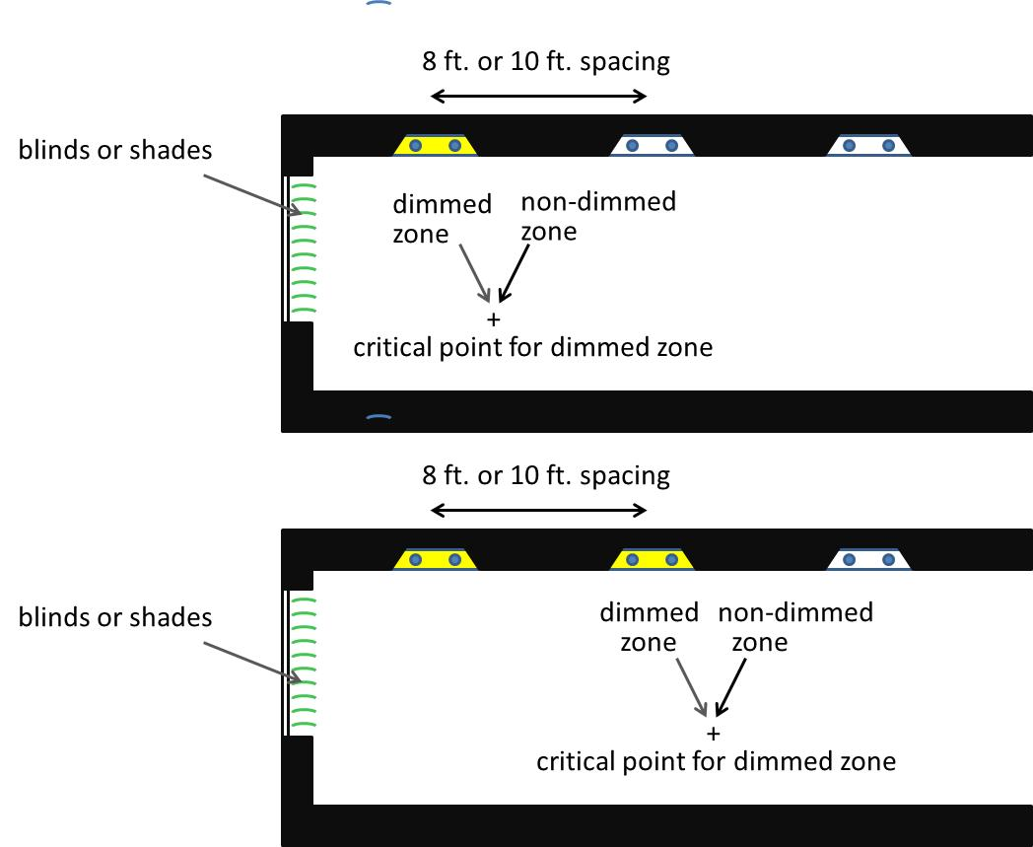
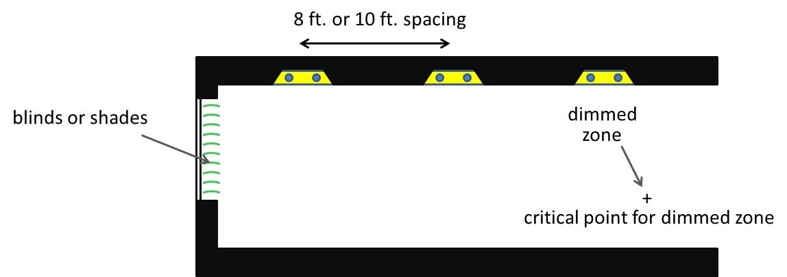
Daylight Calculations
8 ft. and 10 ft. luminaire row spacings are applied.
Different daylight control zones are considered (1 row, 2 rows, 3 rows, etc.).
Critical points are placed four feet from the side walls near the interior edge of each daylight zone.
A 70/30 contribution is considered from the dimmed and non-dimmed zones at the critical point.
Dimming levels are determined for each layout.
Room power levels are calculated.
The configuration with the highest energy savings is applied.

Slide 12
Daylight Output
Monthly electric lighting energy savings table/graph.
Electric lighting power levels at each hour of the year are applied in an EnergyPlus schedule for each perimeter zone.
A shading device schedule is produced for each façade (for EnergyPlus).
Option - Daylight Autonomy contour graphs and Spatial Daylight Automony (sDA_{300 lux,50%}) can be computed for each space (below).
sDA_{300 lux,50%} = 63.5%

Slide 13
Why Airflow Modeling?
Airflow in buildings are either
Intentional (supply/return flow, exhaust…)
Unintentional (infiltration, zone-to-zone leakage…)
Both types play a role in transport phenomena
Heating and cooling
Contaminant transport
Internal unintentional transport typically not modeled, infiltration should be modeled

Slide 14
Infiltration Modeling
Infiltration accounts for up to 25% of load
Modeling is typically very coarse
Standards/guidelines
Rules of thumb
Alternate approach: use CONTAM to compute infiltration based on building airtightness

Slide 15
What is CONTAM?
General purpose multizone airflow simulation code
Often used for contaminant transport simulation
Uses an “element assembly” model of the building
Leakage paths, air handlers, and other components of the model are represented as logical elements

Slide 16
Approach
Translate energy model into airflow model
Run CONTAM to compute infiltration
Process CONTAM outputs to create enhanced energy model
Programmed using the OpenStudio SDK

Slide 17
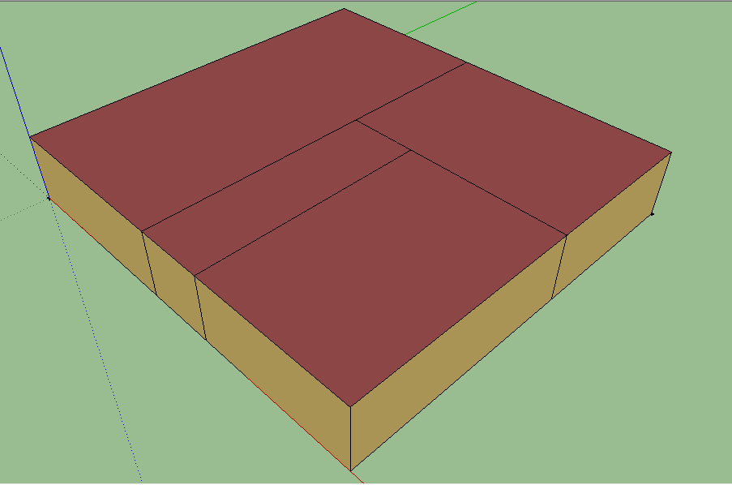
Automatic Translation
Convert energy model objects into airflow model objects
Process is 100% automatic
1
1
2
2
3
4
3
4

Slide 18
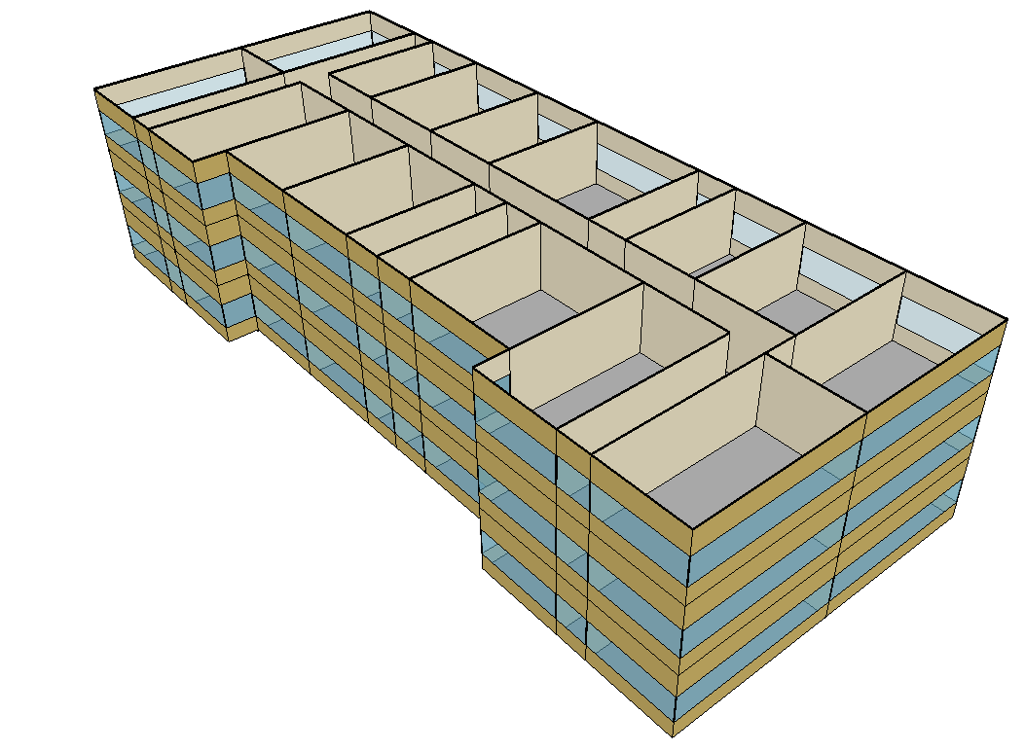
Applications
Infiltration calculation (presently a part of RMT)
HVAC security modeling (described in ASHRAE paper)
IAQ/IEQ building performance assessment
…

Slide 19
Summary on Airflow
Enable enhanced energy modeling with airflow modeling
CONTAM objects are integrated into OpenStudio (as of version 1.1.3)
Current applications include infiltration and security modeling

Slide 20
Modeling Theory
Energy Models
Run Time
Detailed
15 min
Reduce Complexity
Simplified Thermal Zones
9 min
Simplified Geometry
5 min
Reduced Order Model
2 min

Slide 21
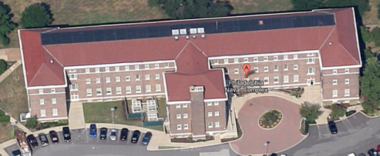
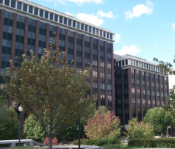
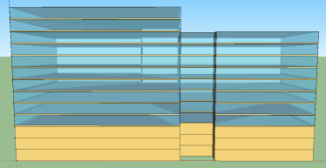
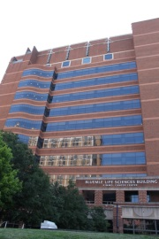
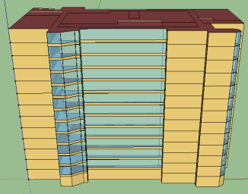
OpenStudio/E+
Validation Case Studies
Building101
User Input
Interactive Output
Geometry
Tracking Sheet
Energy Simulation
Enclosure
Measure Selection
Building Component Library (BCL)
Building Component Library (BCL)
Data
One Montgomery
SUBSTANTIAL
Flow
Typical Room
Energy End-Use
Mechanical
Financial
Lighting
Healthcare/Lab Case Study
Schedules
tools.eebhub.org/game

Slide 22
Retrofit Decisions & Features
Factors that impact retrofit decisions:
Building Type, Size, Location, Age
Financial constraints (capital availability, financial return requirements)
Measure cost & performance uncertainty
Building use, reliability, and disruption constraints
Planned capital projects and maintenance
Energy source uncertainty (price, availability)
Technological change (new technology, regulation of old technology)
Environmental considerations (greenhouse gas emissions, water use)
Indoor environmental quality and productivity impacts
Features for January:
Add new measures (Economizer, service hot water, exterior lighting)
Features for March:
ASHRAE Standard 90.1 HVAC Systems (No3- No8)
Schedule editor
Upload measures to the Building Component Library
Benchmark building with the LEED NC buildings
Editable measure information and cost assumptions
Editable financial assumptions & financial planning tab
Acknowledgements:
PSU: Jin Bin Li, Mujing Wang, Nicholas Mattise, Josh Kuiros, Yang-Seon Kim, Ibrahim Alanqar, and Liusheng Yan
NREL: Kyle Benne, Andrew Parker, Nick Long, Brent Griffith, and Larry Brackney

Slide 23
RMT Measures
Measure Name | Description
Occupancy/Schedule
Heating Set Back | Set back the thermostat heating setpoint from 21°C(70°F) to 13°C(55°F) when unoccupied
Cooling Set Back | Set back the thermostat cooling setpoint from 24°C(75°F) to 32°C(90°F) when unoccupied
Ventilation Set Back | Turn off building ventilation when unoccupied
Plug Load
EnergyStar Equipment | Require that new office equipment be EnergyStar certified, assuming a 15% reduction in equipment power density
Plug Load Control | During unoccupied hours, reduce plug load to 60% of prior unoccupied equipment power density
Lighting
Occupancy-Based Lighting Sensors | During unoccupied hours, reduce lighting power to 80% of prior unoccupied lighting power density
Daylight-Based Dimming | Change lighting schedule to dim lighting to target lighting level when daylight available
Office Lamp/Ballast Retrofit | Replace lamps and ballasts in all office fixtures to T8 with low ballast factor
Luminaire Retrofit | Convert lighting system to 90% of ASHRAE 90.1 Lighting Power Density values
Enclosure
Increase Roof Insulation by R-10 | Add R-20 insulation to roof
Increase Wall Insulation by R-10 | Add R-10 insulation to exterior walls
Increase Wall Insulation by R-20 | Add R-20 insulation to exterior walls
Window Upgrade | Replace windows with low-e, double pane, argon fill windows
Window Film | Install a reflective window coating to lower solar heat gain
Door Weatherization | Weatherstrip doors to reduce infiltration by 5%
Exterior Wall Weatherization | Air seal exterior wall to reduce infiltration by 15%
HVAC
Outdoor Air Economizer | Install an outdoor-air economizer for the venilation system
Condensing Boiler | Install a condensing boiler with 95% efficiency at 120°F return temperature
Condensing Unit Replacement | Replace condensing units with 30% higher efficiency units

